Slide 1
Can RL Models Learn To Collaborate?
By: Arun Ghosh

Slide 2
AGENDA
01
MOTIVATION
02
INVENTING THE GAME
03
TRAINING THE MODEL
04
EVALUATION
05
CONCLUSIONS
06
FUTURE WORK

Slide 3
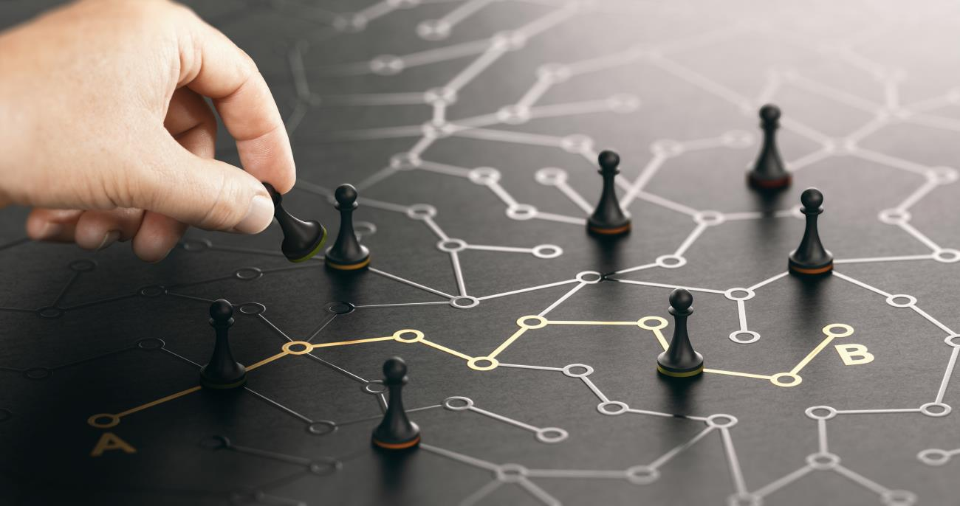
Motivation
Step beyond learning games
Develop strategy and communication
Will trust develop?
Extends to larger game theory problems

Slide 4
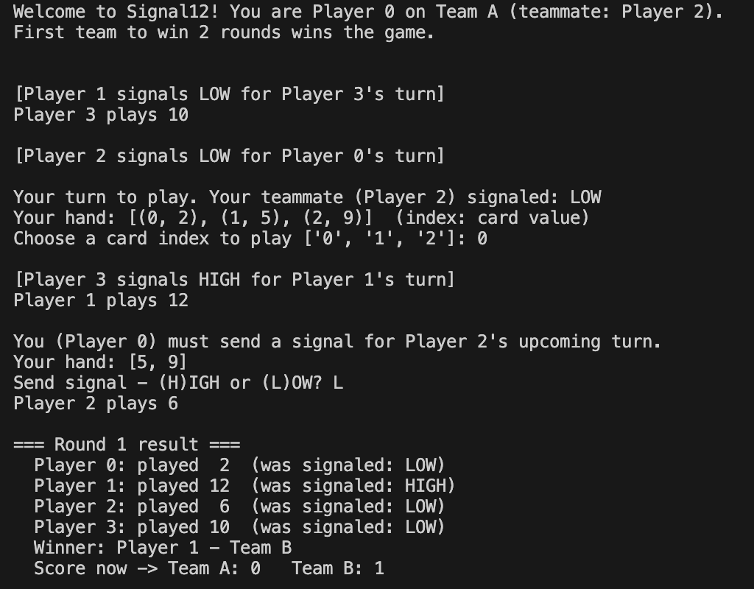
Signal12
Four players divided into two teams
Numbers 1-12 dealt to the players
Each round, every player plays a number
Partner sends a signal (H or L)

Slide 5
Training Process
Develop Architecture
Signal Hand Correlation
Step 01
Card Choice & Signal Agents
Step 04
Trained On Self-Play
Hyperparameter Tuning
Step 02
Step 03
Step 05
Evaluate v.s.
Random
Step 06

Slide 6
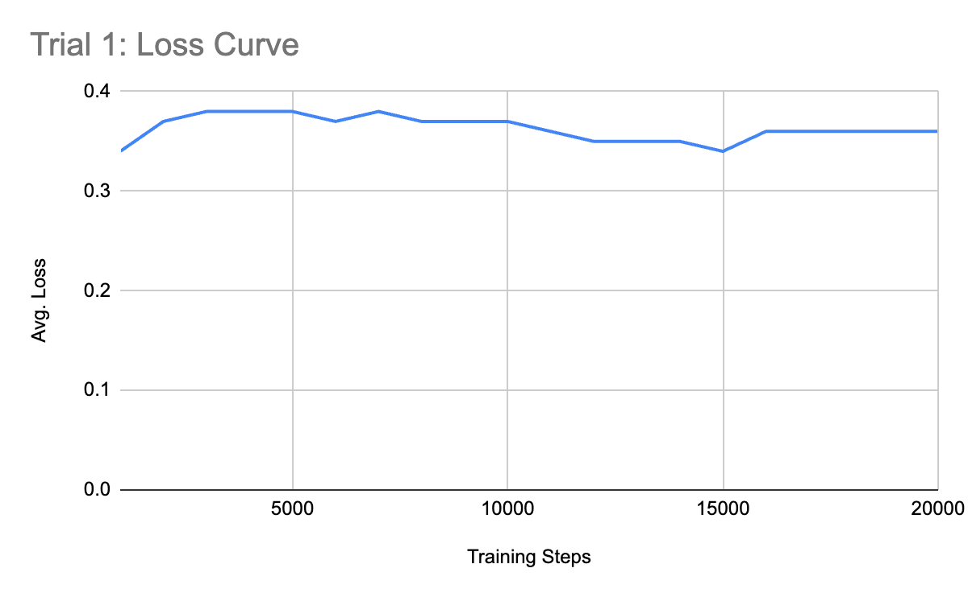

Slide 7

Evaluation
Trial 1: beats random 60% of the time
Tried learning signal and card choice separately
Trial 2: beats random 54% of the time
Little evidence of learning communication

Slide 8
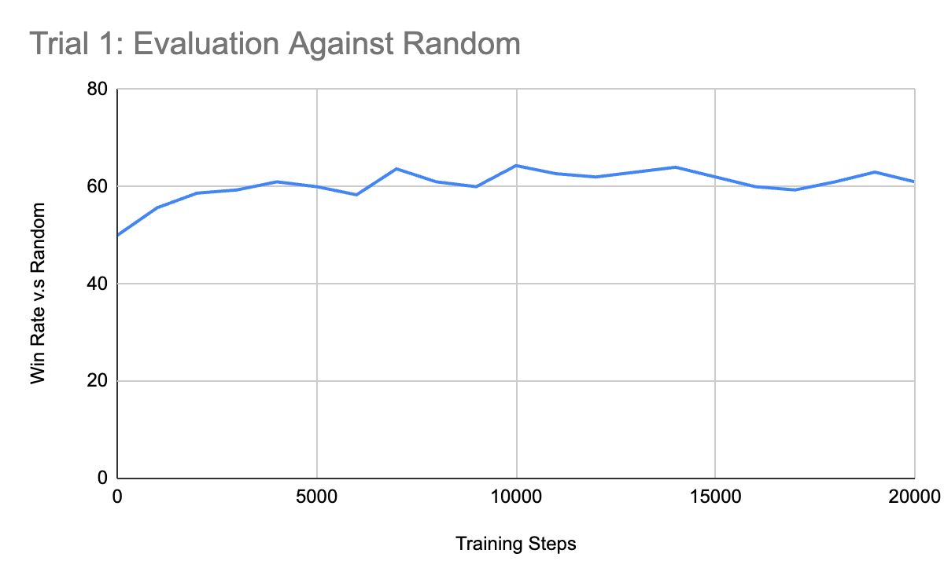

Slide 9
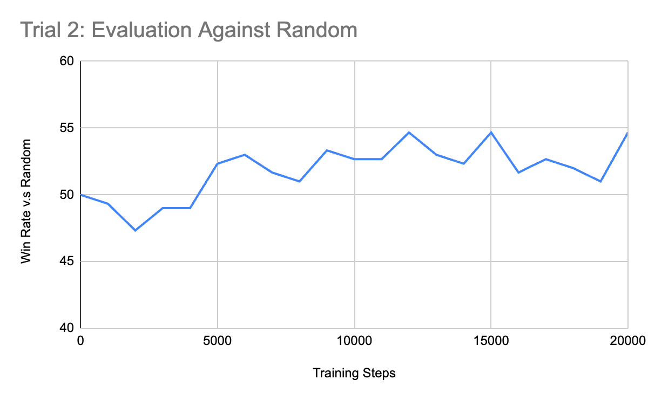

Slide 10
Conclusions
Need a better way to learn signaling
Signal12 has a large luck component (perhaps Signal 20+ has more strategy)
Both trials still surpassed random (slight evidence of learning)

Slide 11
Future Work
01
02
03
04
We are here
RL models learn to play chess
RL models learn to detect amount of strategy in a game
RL models learn to communicate with users in signaling games
RL models used for process simulation / optimization

Slide 12
THANK YOU
Any questions?

